Slide 1
Making Inferences
What do you know?
What clues did you find?
What can you conclude?
What can you infer?

Slide 2
Why is this man on the floor? What makes you think so?

Slide 3
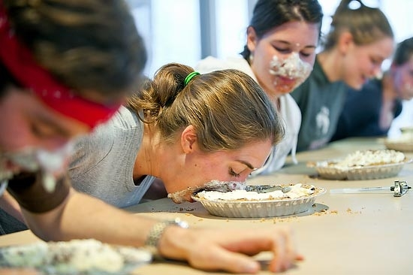
Why isn’t this woman using a fork to eat her pie? Why do you think so?

Slide 4
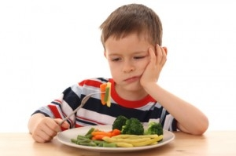
What do you think this boy is thinking? What makes you think so?

Slide 5
When was this picture taken? How do you know?

Slide 6
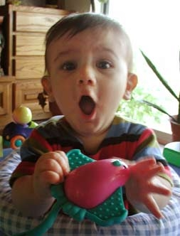
How do you think this boy is feeling? What makes you think so?

Slide 7
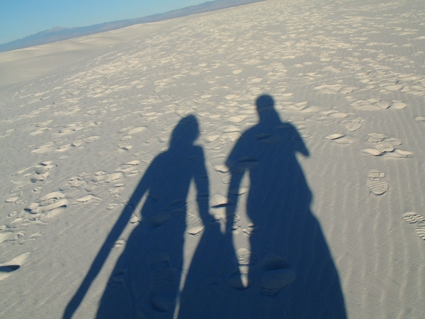
What are two things you can say about the people who cast these shadows? What makes you think so?

Slide 8
Where is this girl? How do you know?

Slide 9
What do you think is in this person’s backpack? Why do you think so?

Slide 10
Where are these girls? What makes you think so?

Slide 11
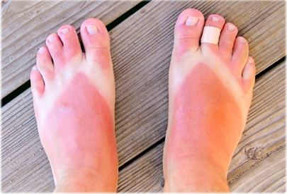
What are three things you can tell about the person whose feet these belong to?

Slide 12
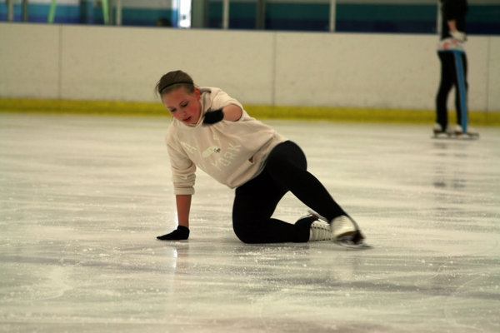
What just happened? What makes you think so?

Slide 13
How is this man feeling? How do you know?

Slide 14
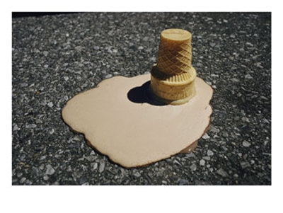
What happened? What makes you think so?

Slide 15
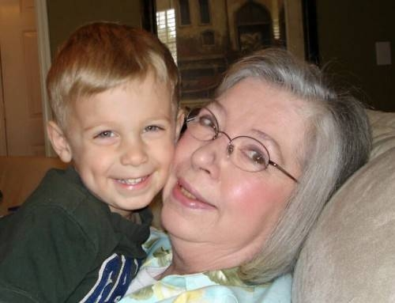
How do you think these two people know each other? What makes you think so?

Slide 16
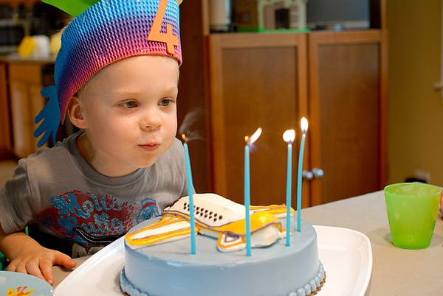
What are two things you could say about this little boy?

Slide 17
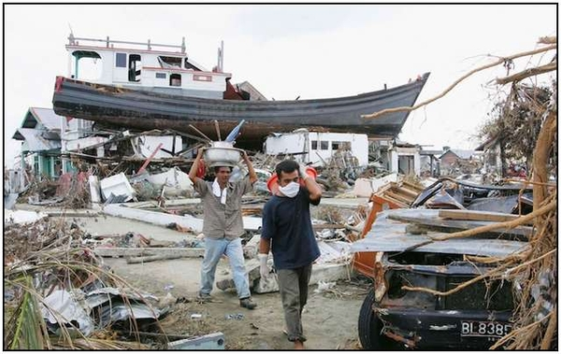
What do you think happened here? What makes you think so?

Slide 18
How is this girl feeling? What makes you think so?

Slide 19
How is this girl feeling? What makes you think so?

Slide 20
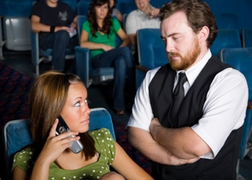
What is this man going to say to this girl?

Slide 21
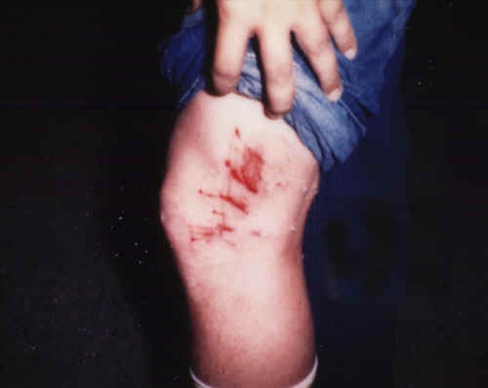
What do you think caused this injury? What makes you think so?

Slide 22
What will this woman have for breakfast tomorrow? What makes you think so?

Slide 23
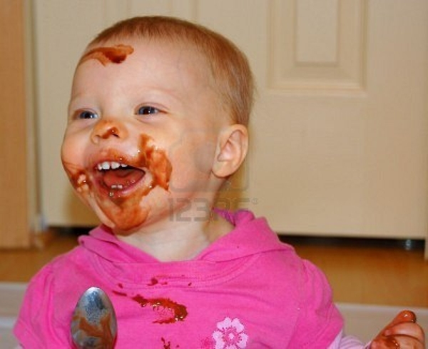
What has this little girl been doing? How do you know?

Slide 24
To make an inference, you need to activate your prior knowledge and merge it with the text clues that the author gives you. Now you have an inference!
Background Knowledge BK + | What the author tells you (text clues) TC = | Inference I

