Slide 1
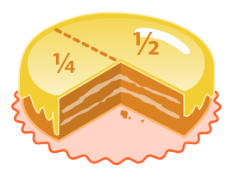

Fractions Unit
By Miss O.

Slide 2
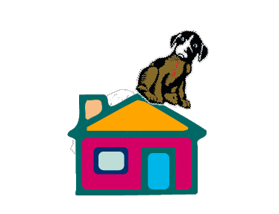
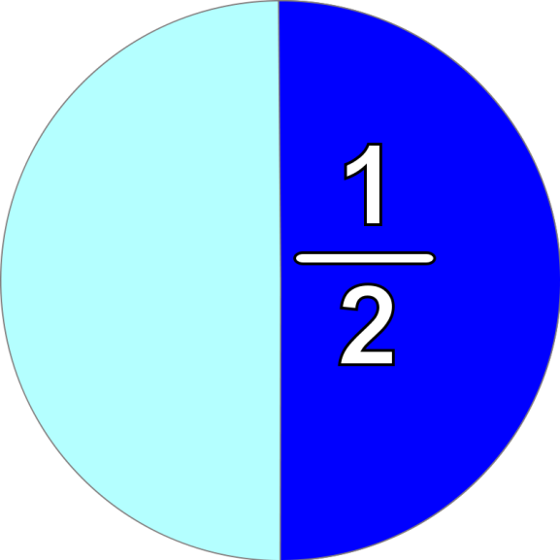
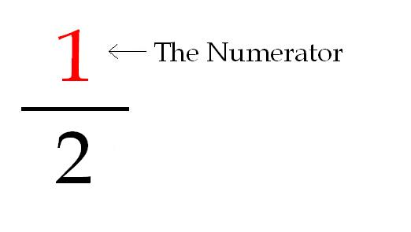
Numerator = # on top
Denominator = # on the bottom
(down below)
How many equal parts are described?
The Denominator
How many equal parts are in all (total)?
You can also write it: 1/2

Slide 3
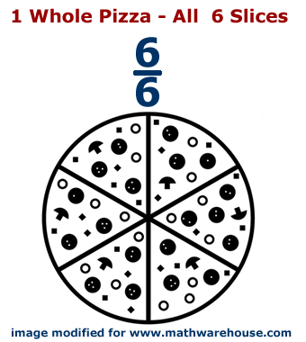
Parts of a Whole
Whole = 1 complete thing
Different from a hole in the ground

Slide 4
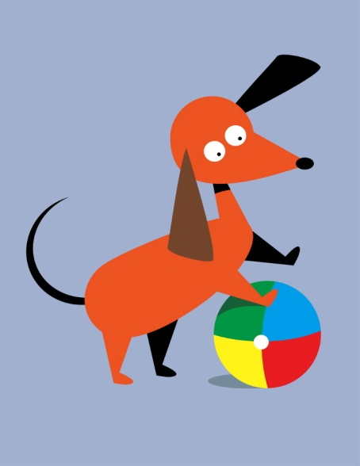
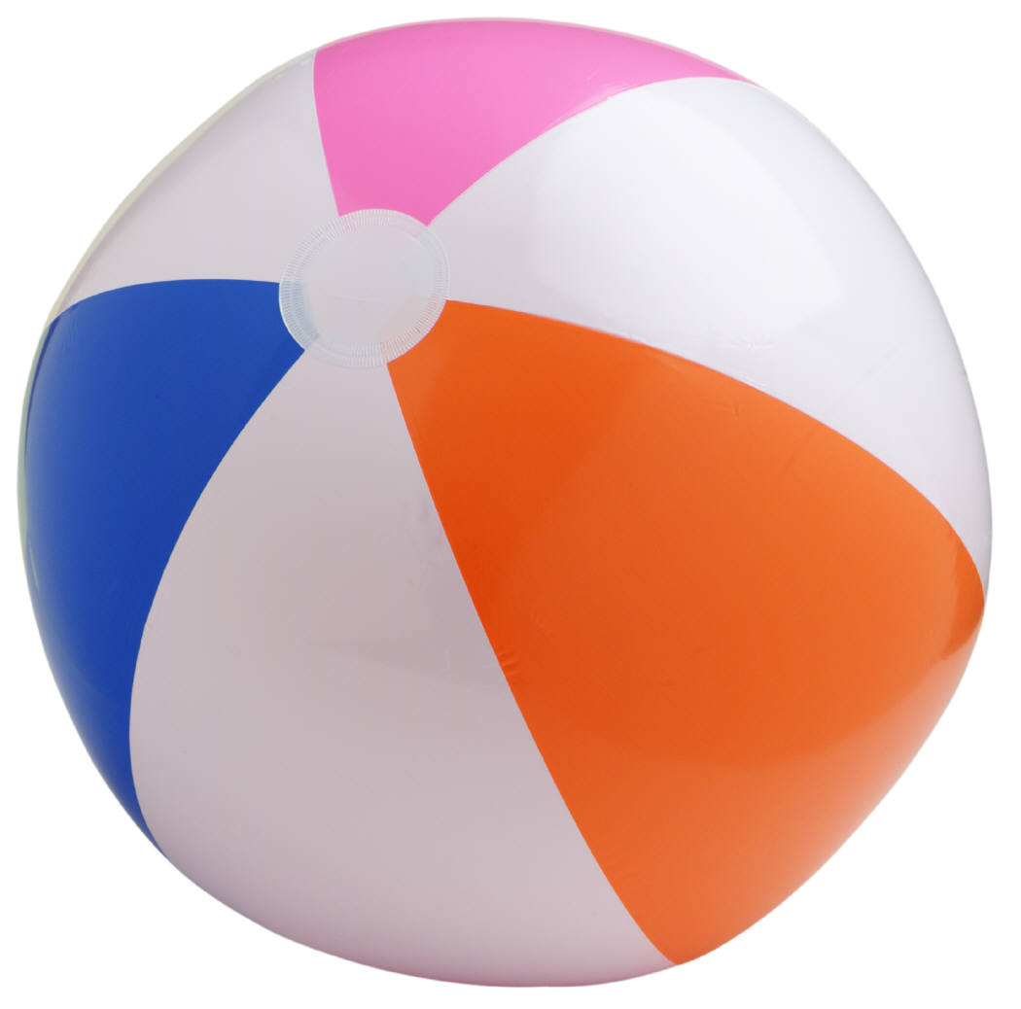
1 WHOLE → fraction
The top number and the bottom are the same!
4 5 8 55 86
4 5 8 55 86
Give me some more fractions that equal 1 whole!

Slide 5
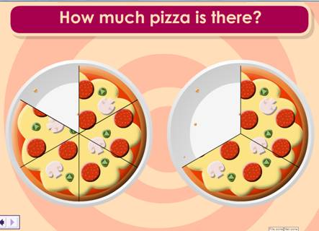
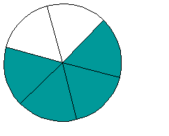
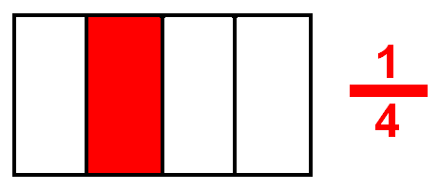
Parts of a Whole
4/6

Slide 6
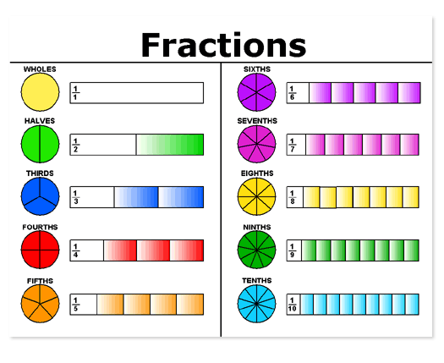

Slide 7

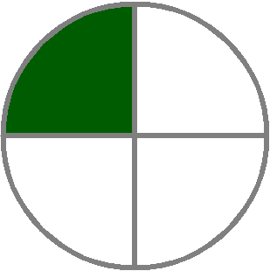
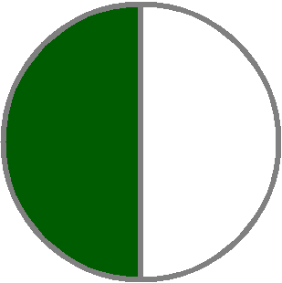

Parts of a Whole
What’s the fraction we should write for each?

Slide 8

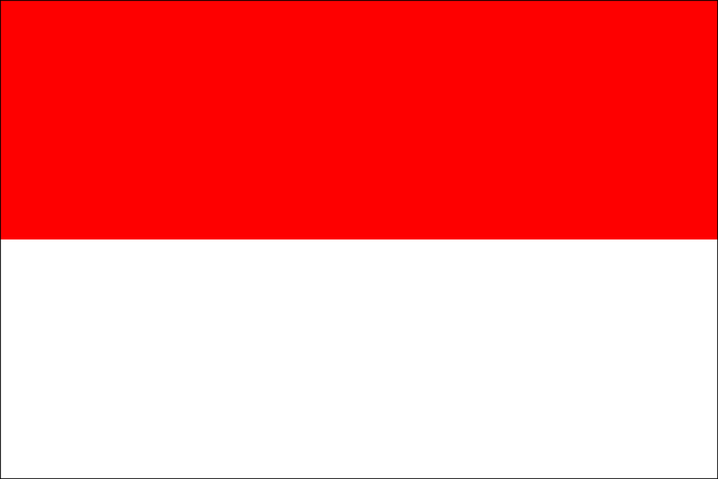
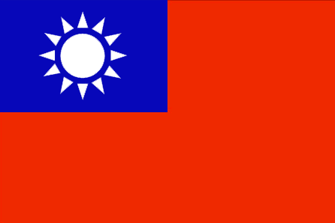



Write a fraction for the part of each flag that is red.
Italy
Indonesia
Taiwan
Austria
Germany
Spain

Slide 9
Draw a model to show each fraction:
3 4 1
10 8 6

Slide 10
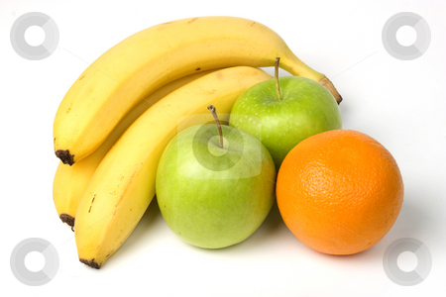
Parts of a Set
What is the total number of fruits?
  This will be your denominator!
  What fraction of this set are bananas?
  What fraction of this set are oranges?
  What fraction of this set are apples?

Slide 11
What fraction of each set is blue?
Draw a picture to show the fraction 3/5 as part of a set!

Slide 12

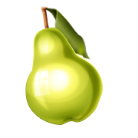
If 1/3 of a set is apples, what part is NOT apples?

Slide 13
Draw a model of a set to show each fraction.
2 1 5 7
3 5 6 8

Slide 14
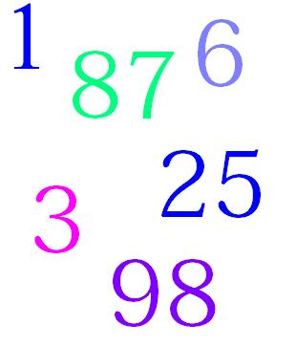
Whole Number
Whole number: regular whole numbers without fractions.
Talk with a partner, think up and write 6 more WHOLE NUMBERS
on your white board.

Slide 15
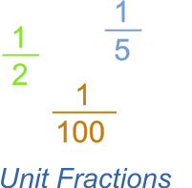
Unit Fraction
Unit fraction: fraction with a smaller number on top (numerator) than the bottom (denominator)
Talk with a partner, think up and write 6 more UNIT FRACTIONS
on your white board.

Slide 16
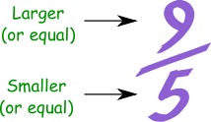
Improper Fraction
Improper Fraction: where the top number (numerator) is one and the bottom number (denominator) is another number
Talk with a partner, think up and write 6 more IMPROPER FRACTIONS on your white board.

Slide 17
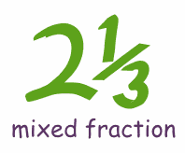
Mixed Number
Mixed Number: A whole number WITH a fraction.
Whole Number
Talk with a partner, think up and write 6 more MIXED NUMBERS on your white board.
Fraction

Slide 18

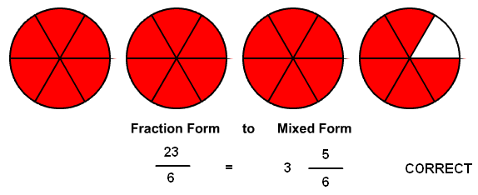
Mixed Number Models
Mixed Number = A whole + a fraction
3 wholes + 5/6 (fraction) = mixed number

Slide 19

Complete These Statements:
A unit fraction is where the numerator is _____________ and the denominator is _____________.
A mixed number is the sum of a _____________
and a ________________.
The __________________ is the number on the bottom of a fraction, and the _________________ is the number on the top of a fraction.

